Slide 1
Airport App Project
By: Ivan Baydov (team leader), Diana Alkajo, Elijah Barchue

Slide 2
Application Goals
The goal of this “Airport App” is to improve passengers’ experience by providing them with real-time information, self-service options, help them to navigate different places located, and access the services they need all in one place.
This app will be designed to be user-friendly and easy to navigate, even for first-time users.
This app will include features to enhance passenger experience such as:
The ability to book a flight which will display the date, flight number and time on a notification board which will look like a calendar, leave feedback about the airport and its services.

Slide 3
Application Requirements
In addition to the features mentioned above, the app will also include core features like
Real-time flight information, including arrival and departure times, gate numbers, and delays and cancellations
Interactive maps of the airport, including every gate number location, restrooms, restaurants, and other amenities
Information about airport services, such as parking , baggage claim, ground transportation.
The ability to receive push notifications about flight changes and other important updates

Slide 4
Programming Language & Tool/ Team Communication Method
The Programming language to be used is Java
The application will be created using Android Studio
Group members will meet once a week in-person on Fridays to work on the application together and will be on discord throughout the week for any additional things.

Slide 5
Project Tracking Tool
Most work done with group members will be by using GitHub.
Each member will update their assigned work on GitHub so that it is shared with others and to keep track of what steps to do next.
The work on the project will be divided equally so that each member gets the same amount of work.
We will be using Trello for tracking our progress and creating a schedule.

Slide 6
Potential Risks
Having difficulty on understanding Android Studio’s syntax/building the app.
Working with or understanding on using API data based off Toronto Pearson Airport.
GitHub code merge conflict issues.

Slide 7
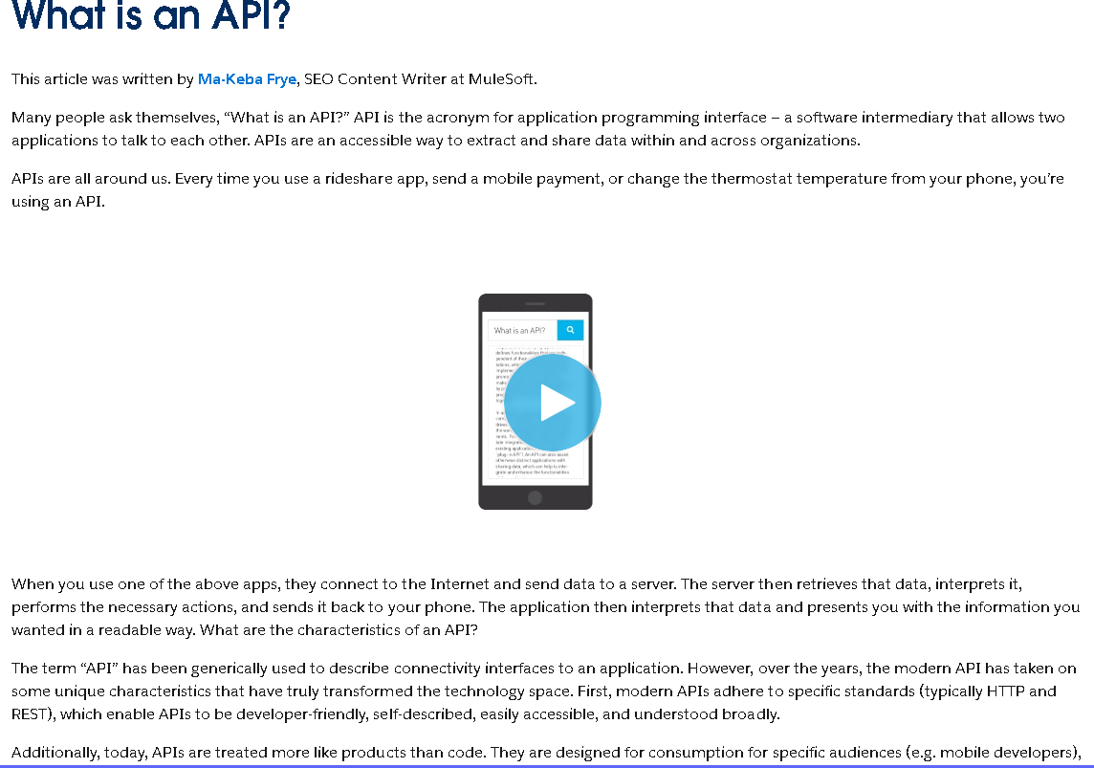
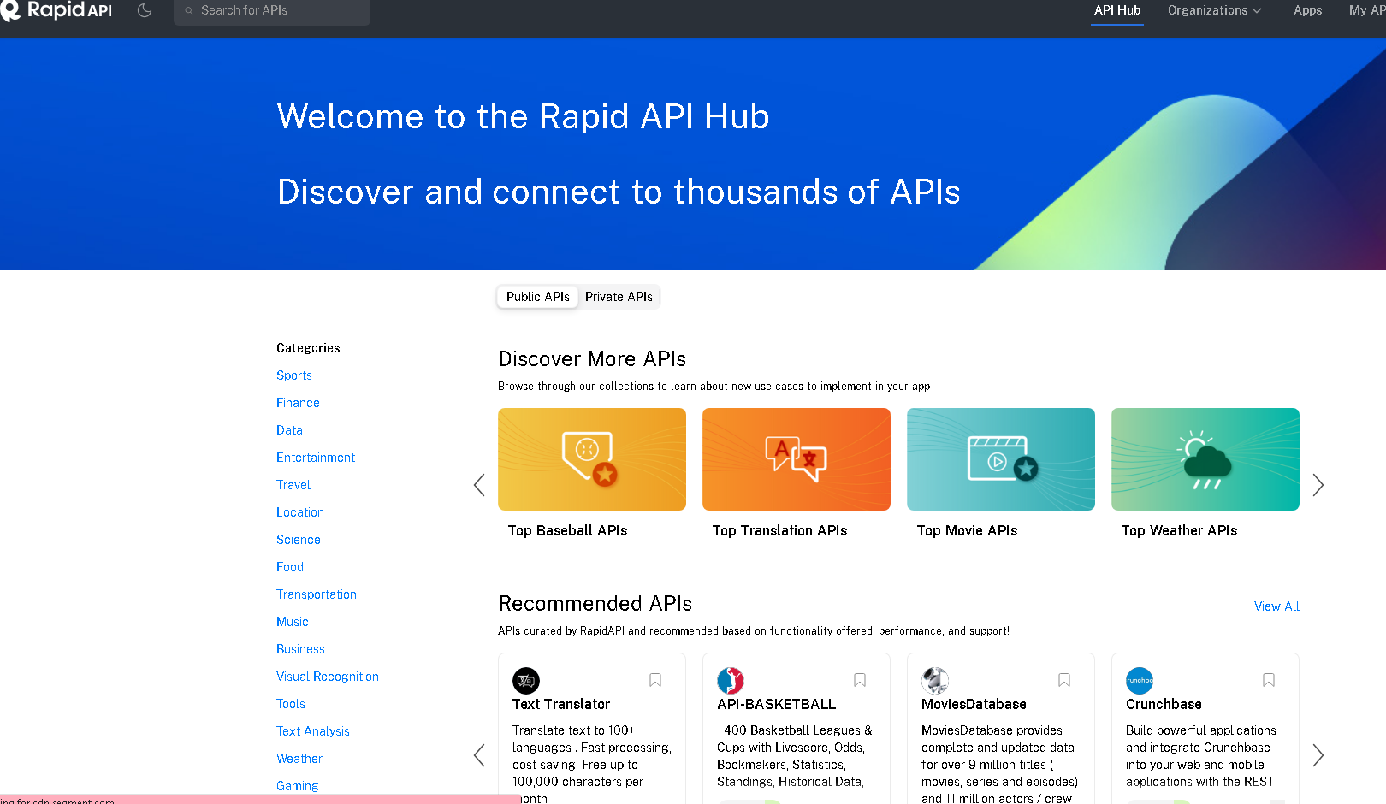
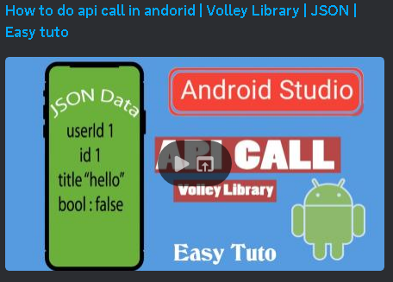
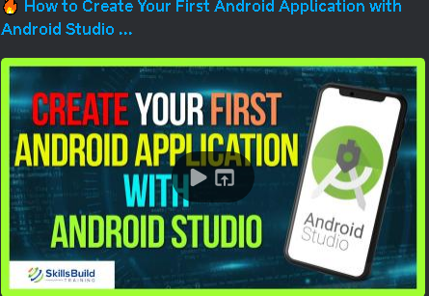
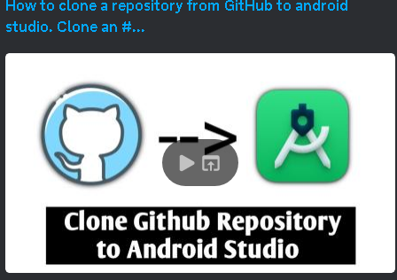
References
https://www.mulesoft.com/resources/api/what-is-an-api
https://rapidapi.com/
https://www.youtube.com/watch?v=fQjA1CwV8lE’
https://www.youtube.com/watch?v=uPkjgVv5Ioc
https://www.youtube.com/watch?v=MgEsNXwj0lY

